Slide 1


Presenter
Dr Catherine Mwakosya & Dr Mathew Silas
FISHERIES STOCK ASSESSMENT: CAPACITY-BUILDING TRAINING FOR SOMALIA'S MINISTRY OF FISHERIES AND BLUE ECONOMY STAFF
MODULE I
Fundamentals and concepts

Slide 2
Key guiding questions
What is sustainable fisheries management?
What is fish stock assessment, and why is it crucial for sustainable fisheries management?
Why is fish stock assessment in important in sustainable fisheries?
Which fisheries to focus on stock assessment?
How assessment results inform policy, regulations, and conservation efforts.
What are key requirements (challenges and limitations) to undertake fish stock assessment? Acknowledging the inherent uncertainties and complexities in assessing wild fish populations.
Ecosystem-Based Fisheries Management (EBFM), an approach to managing fisheries that goes beyond catch data for a single species by considering the entire ecosystem:
Integrating ecological, social, and economic considerations into fisheries assessment and management.
Linking stock assessment results to ecosystem management

Slide 3
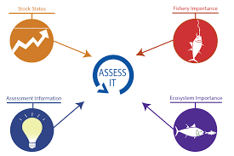
What is fish stock assessment
A fishery stock assessment is the scientific process of collecting, analysing, and reporting on the condition of a fish stock and estimating its sustainable yield.
Stock assessments are the backbone of sustainable fisheries management.
.

Slide 4
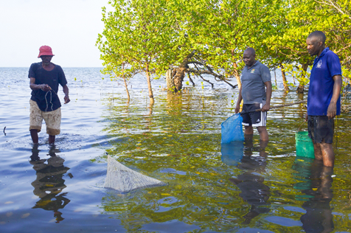
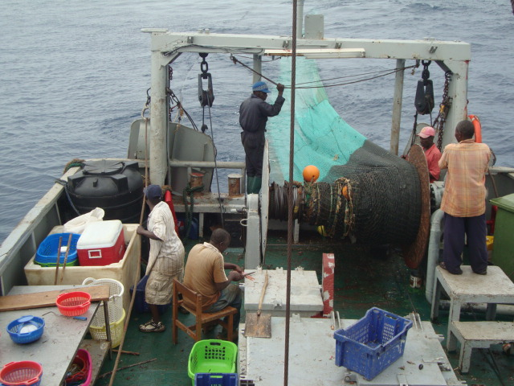
What is fish stock assessment
Stock assessment rely on two data
(1) fishery-dependent data, or information
collected from fishermen and dealers on catch, landings and effort;
and
(2) fishery-independent data, or information collected by scientists via a long-term research survey or other scientific study.
.

Slide 5
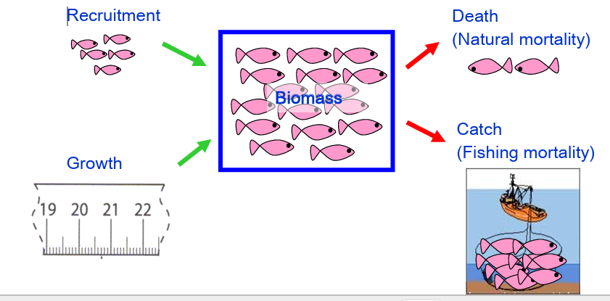
Why Assess Fish Stocks?
To determine their status, to evaluate how they may be affected by potential management actions, and to forecast their future conditions.
To define desirable conditions or benchmarks which indicates status, derived from estimation of either abundance or weight (biomass) references
o

Slide 6
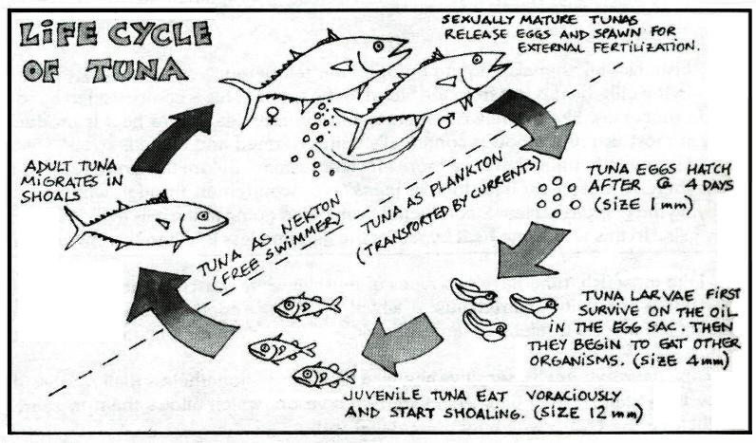
Concepts-Life history
  Age & Growth:. Understanding rate at which approaching maximum size
  Feeding: Understanding feeding trophic levels and strategies
  Reproduction: Fecundity, reproductive peaks tracing life cycles
  Habitat: Loss of habitat and water quality significantly affects the health of fish stocks. Habitat considerations need to be included in management plans.
  Natural Mortality: M is critical and therefore incorporated into most population dynamics models.

Slide 7
Concepts – population dynamics
Recruitment: is the number of fish born within a given time period that survive to the juvenile stage.
Growth: How fish size and weight change over time,
Mortality: is the number of fish dying within a given time period. .
Natural Mortality (M):
Fishing Mortality (F):
Total Mortality (Z): The sum of natural and fishing mortality

Slide 8
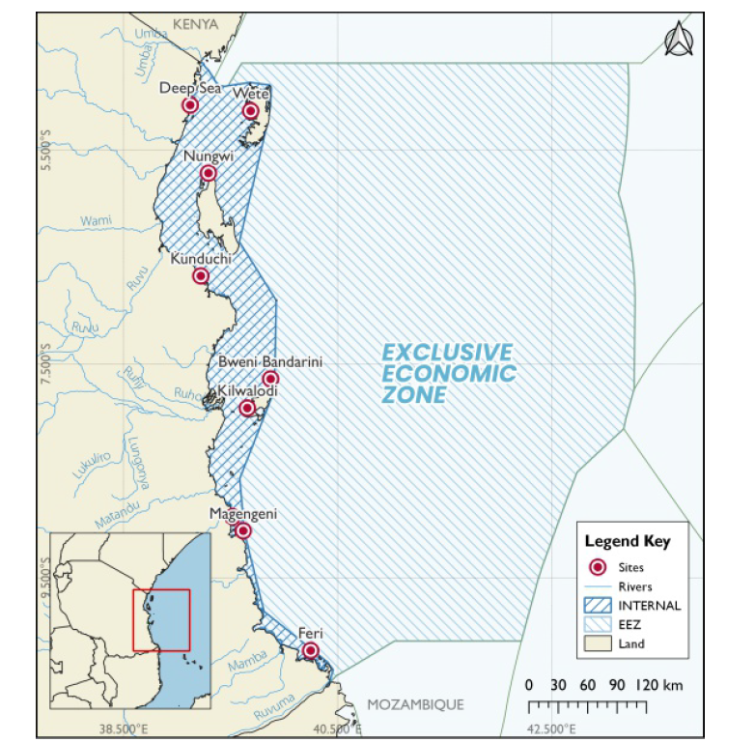

Slide 9
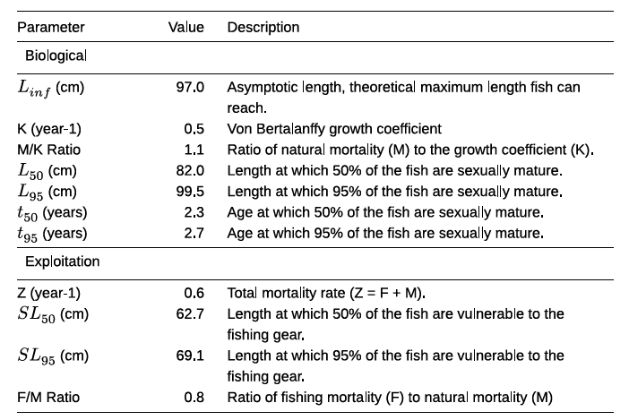
Concepts –reference points
Biological
Exploitation

Slide 10
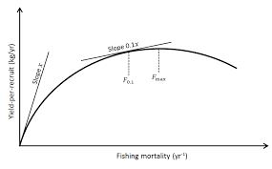
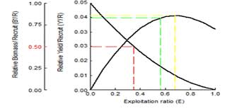
Concepts- Exploitation –Yield per recruits
Yield per recruit:
  Understanding how fishing pressure affects the catch from a cohort.

Slide 11
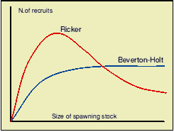
Concepts- Exploitation –Stock-recruitment relationship
Stock-recruitment relationships:
How spawning stock size influences future recruitment

Slide 12
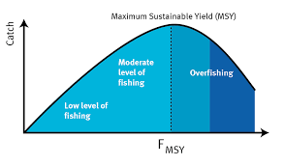
Concepts- Exploitation –Maximum sustainable yield (MSY)
Maximum sustainable yield (MSY):
The theoretical maximum catch that can be taken from a fish stock indefinitely without impairing its ability to replenish.

Slide 13
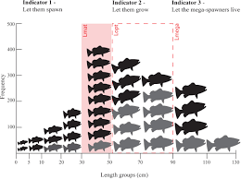
Concepts- Exploitation –Overfishing
  Growth overfishing: Catching fish before they have had a chance to grow to their optimal size.

Slide 14
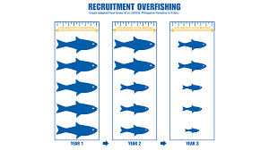
Concepts- Exploitation –Overfishing
  Recruitment overfishing: Reducing the spawning stock to a level where it cannot produce enough recruits to sustain itself.

